Slide 1
WELCOME TO YEAR 1
2025-2026

Slide 2
TEACHERS
1G | 1B
Gemma Raw | Blaire Gove
LSAs –Debbie Smith | LSAs –Sam James Valbona Tahiri

Slide 3
GENERAL INFORMATION ABOUT YEAR 1
Year 1 can feel like a big step up from Reception, as children are encouraged to take part in more group-based activities and the play becomes more structured. However, there are still plenty of opportunities for learning through play. Our classrooms are carefully designed to promote this, with areas such as construction and role play available for the children to explore.
We are currently developing our outdoor area to provide even more opportunities for active and creative learning. In the afternoons, the outdoor space is set up for children to access and enjoy.
In the Summer term (June), all Year 1 children will take part in the national Phonics Screening check. You will be invited to an information meeting about this closer to the time.
Throughout the year, there are lots of exciting opportunities and events for the children, including our Christmas celebrations, school visits, Sports Day, and much more.

Slide 4
Timetable
The children take part in whole-class daily inputs for all subjects.
In English, they currently complete one teacher-led writing activity in a small group each week. On other days, they access continuous provision, which includes a variety of activities such as role play, fine motor skills, playdough, and drama to support their learning.
In Maths, the children begin with a whole-class input. With the support of the teacher and LSA, they then complete their related task in small groups using their PowerMaths books
In the afternoons, children are taught a variety of subjects across the week. These sessions are delivered as whole-class lessons and are often followed by small-group or whole-class activities. These provide opportunities for consolidation, further learning, and the development of group work skills.
 | Monday | Tuesday (PPA) | Wednesday | Thursday | Friday
8:30 – 8:55 | EMW and register | EMW and register | EMW and register | EMW and register | EMW and register
8:55 - 9:20 | Phonics | Phonics | Phonics | Phonics | Phonics
9:20- 10: 00 | Maths | Maths | Maths | PE (outdoor) | Maths
10:00 - 10:15 |  |  |  |  | ASSEMBLY
10:15 - 10:30 | B | R | E | A | K
10:30 - 10:45 | Handwriting | Handwriting | English Music ( 11:25-11:45) | Handwriting | Handwriting
10:45 - 11:45 | English | English |  | English | English
11:45 - 1:00 | L | U | N | C | H
1:00 - 2:15 | Geography/History Continuous Provision/ Readers ASSEMBLY 2:45 - 3:00 | RE 1:00-1:45 | SINGING ASSEMBLY 1:00-1:30 | Art/ D&T | Computing/PSHE
 |  |  | Science 1:30-2:15 Continuous Provision/ Readers
2:15 - 3:00 |  | PE - Continuous Provision & Readers 1:45-3:00 |  | Continuous Provision/ Readers | Continuous Provision/ Readers
3:00 - 3:15 | Story time/ end of day routine | Story time/ end of day routine | Story time/ end of day routine | Story time/ end of day routine | Story time/ end of day routine

Slide 5

- The children will take their Year 1 Phonics Screening in June.
- The screening consists of 20 ‘real’ and 20 ‘alien’ words. The children have to read these words however they do not need to tell us if they are real or not. The ‘alien’ words will have an alien next to them.
- The alien words are there to make sure the children are using their sounds to decode words instead of sight reading.
- We will be teaching phonics every day.
- If the children do not pass, they will retake the screening in Year 2.
- A great way to practice for the screening is by using Phonics Play:
https://www.phonicsplay.co.uk
- More information regarding the phonics screening will be given in the Spring and Summer curriculum meetings.

Slide 6
How to say the sounds:
https://cdn.oxfordowl.co.uk/2016/05/05/20/22/32/561/20097_content/index.html?id=ae
Digraph – a sound made up of two letters e.g. au (haunted) or ai (rain).
Trigraph – a sound made up of three letters e.g. ear (spear) or air (chair).
Split digraph – a sound made up of two letters, split in the middle e.g. u_e (flute) or o_e (bone).

Slide 7

READING
- All children will have a set reading day; this is when they will read their given book with their teacher or LSA
- The children need to bring their reading books into school with them everyday as we might also get a chance to do some extra reading with them on a different day.
- We encourage you to read your child’s banded reading book with them at least 4 times a week.
-Children are also encouraged to borrow a book from our class library for you to read to them. We have a wide variety of fiction and non-fiction books for them to choose from and this will expose them to a wider vocabulary and develop their reading for pleasure.

Slide 8
ENGLISH
- We focus on a different text either weekly or fortnightly. The children will complete different activities such as role play, ‘hot seating’, story ordering and a written piece of writing in different formats such as a letter, story or character description.
- The main focuses for the Autumn term will be continuing to encourage the children to use their phonics so that they can sound out words more independently, full stops, capital letters, finger spaces and letter formation. We will also be encouraging the children to think about adjectives.

Slide 9
MATHS
- The scheme used for maths is called ‘Power Maths.’
The children will each have their own workbook which they will complete a set of pages of each week.
The topics for the Autumn term are:
Numbers 1 – 10 (sorting, one more/one less, ordering, first, second, third).
Part-whole within 10 (number bonds).
Addition and subtraction within 10.
2D and 3D shapes (naming and patterns).
Numbers to 20 (counting, one more/one less, ordering, comparing).

Slide 10

HOMEWORK
- Homework is given out every Thursday and is due back in on the following Tuesday.
- The homework usually consists of an activity relating to our learning for the week. The activities will alternate between English and Maths.
https://docs.google.com/document/d/1w2FMGL3M1VrZsw4LxvlCfUolrQ6sfBiP/edit

Slide 11

HOW CAN YOU HELP AT HOME?
Phonics: Children will be bringing home sound mats, which are the same ones we use in school. These can be used to support their writing at home. Please encourage your child to listen carefully for the sounds they can hear in words and write these down, rather than giving them the correct spelling straight away.
Reading (Phonics Focus): When reading, encourage your child to spot digraphs and trigraphs (two or three letters making one sound). For example, in the word brain, guide them to first recognise the ai sound before blending the word.
Reading (Comprehension): Alongside sounding out, encourage blending and ask lots of questions about the book. Talking together about the story and characters will help develop your child’s comprehension skills.
Handwriting: We follow the Oxford Owl Nelson Handwriting scheme. Each week, we will let you know which letters the children have been learning. Please encourage your child to practise forming these letters correctly at home.

Slide 12
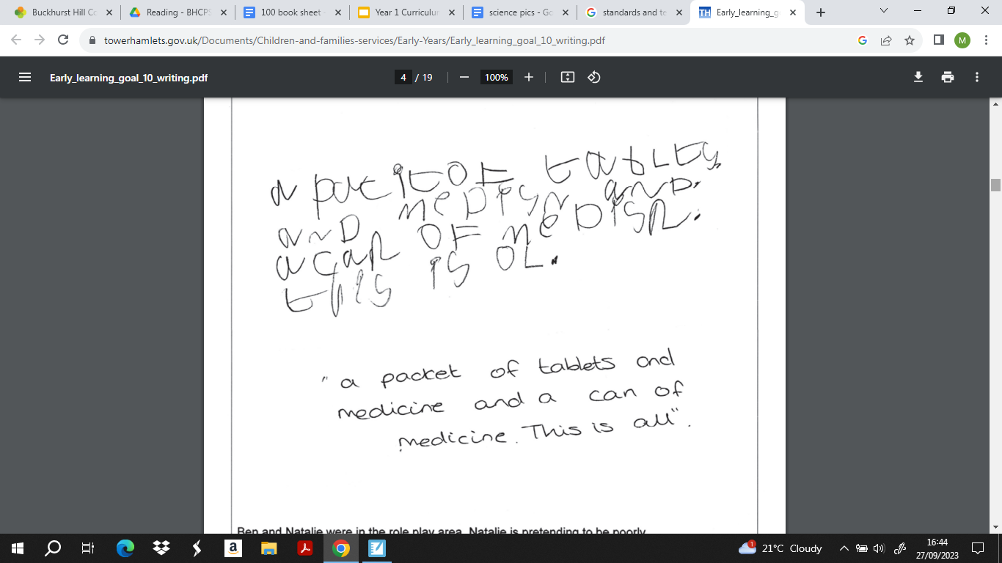
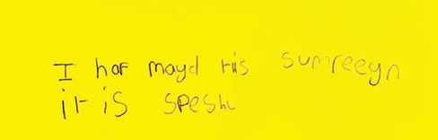

Slide 13
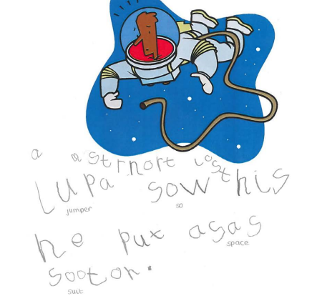

Slide 14

PE
- PE will be taught on Tuesdays and Thursdays.
- The children will need to arrive in school in their PE kit.
- The kit should include navy blue shorts and t-shirt or a navy-blue jumper and jogging bottoms for the winter.
- Shoes can include black plimsolls or white, navy or black trainers.
- No earrings should be worn on these days.

Slide 15
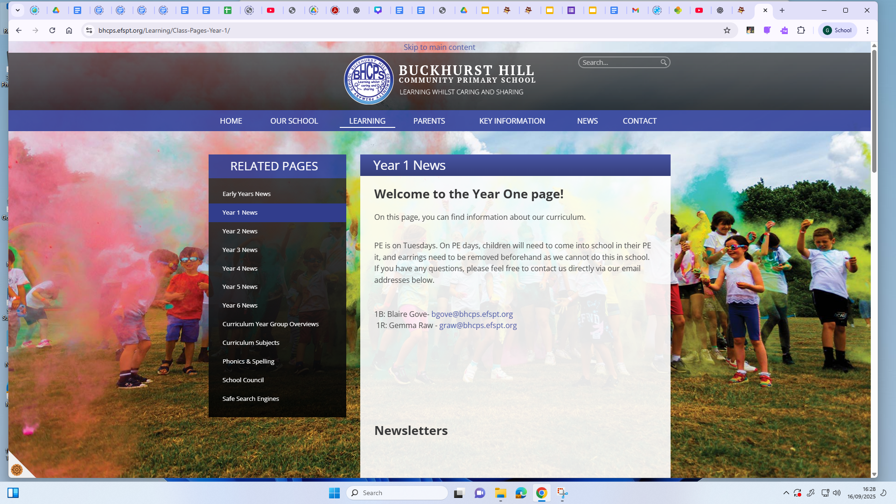
CURRICULUM
- You can find the curriculum information for the year on the school website. https://www.bhcps.efspt.org/docs/YEAR_1_CURRICULUM_OVERVIEW_2024-2025_docx.pdf
- The website also features a Year 1 class page where we will the newsletters and other helpful links for you to use at home – be sure to check it out. https://www.bhcps.efspt.org/Learning/Class-Pages-Year-1/

Slide 16

ANY QUESTIONS?
We are on the door every morning and afternoon and are always happy to answer any questions! Please don’t hesitate to get in touch using the email addresses below:
Gemma Raw: graw@bhcps.efspt.org
Blaire Gove: bgove@bhcps.efspt.org

